Slide 1
O&R 2026
Local Transmission Plan (LTP) Assumptions
9/17/2026

Slide 2
Agenda
O&R System Overview
O&R Planning Areas
Local Planning Studies
O&R Firm Definition
Line 705 Project
Contact Information

Slide 3
O&R System Overview
Service Territory: ~1,300 square miles, covered across 7 counties that also includes NJ
Total NY Customers: ~239,000
Total NJ Customers: ~70,000
All Time System Peak: 1,617 MW (2006)
Transmission System Facilities: 34.5kV-345kV
Planned as integrated system
  Approximately 70/30 load ratio (NY/NJ)
  Net load flow NY → NJ

Slide 4
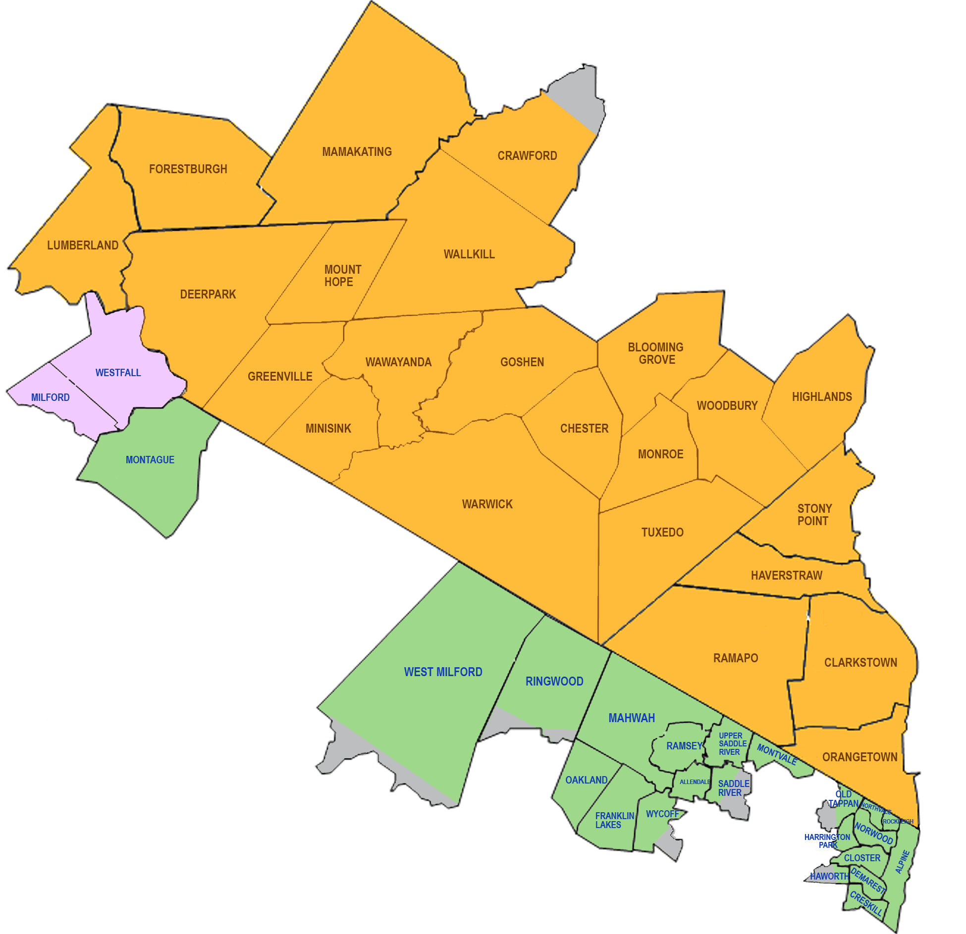
O&R Planning Areas
Central Division
Western Division
Eastern Division
Electric Service Territory
Orange and Rockland
Rockland Electric Company
Pike County Light & Power

Slide 5
Local Planning Studies
FERC 715 as base case
10-year Planning and Analysis horizon
  Address new violations and validate existing solutions
2035 System Coincident Peak Forecast: 2,165* MW
  10-year substation level coincident forecast applied to model
  CAGR: 3.6% over ten years
  *Weather Normalized
Planning Criteria (Revision 16)
  N-1; Thermal: Rate A (Normal), Voltage: ±5% nominal
Software:
  Siemens PSSE Ver 35.6; PowerGEM TARA Ver 2503

Slide 6
O&R Firm Definition
O&R Firm Project would consist of the following:
  Funding: The project is included in the rate case, meaning it has been reviewed and approved for cost recovery through customer rates or cost recovered from customers and developers.
  SIS Determination: SIS for project is completed, if required.
  Permitting: The project has obtained Article VII certification and/or other necessary permits, which is a regulatory approval for the construction and operation of major utility transmission facilities.
  Major Equipment Ordered: The major equipment for the projects have been ordered and/or awaiting delivery.

Slide 7
Line 705 Project
Project Description: Line 705 will be a new 138kV underground transmission line between Burns 138 kV substation and West Nyack138 kV substation. It will be connected to a new 138/69 kV auto transformer in the West Nyack substation.
Project Driver: Improve reliability and address thermal and voltage violations in the Orangeburg, NY area due to load growth. Line 652, a 69kV transmission line, is limited by conductor capacity and experiencing thermal constraints under specific contingencies. Line 705 will add capacity and improve reliability.
Project Type: Firm
Project Status: Under Construction
Proposed In-Service Date: Spring 2027

Slide 8
Forest Avenue Substation Project Need
Project Description: A new 69kV distribution substation between Monroe 69kV substation and Harriman 69kV substation. It will be connected to 69kV Line 312 in O&R's Central Division.
Project Driver: Load growth in area served by Monroe and Harriman substations can no longer be supported by existing facilities. More feeder and transformer capacity is needed to supply load reliably and pass design criteria. Existing substations cannot accommodate more equipment.
Project Type: Firm
Project Status: Under Construction
Proposed In-Service Date: Spring 2027

Slide 9
Contact Information
Interested parties may submit written comments within 30 days to:
  George Cocks
  Section Manager – Transmission Planning
  Orange & Rockland Utilities, Inc.
  390 W Route 59
  Spring Valley, NY 10977
  cocksg@oru.com
  845-577-3431
O&R LTP will be posted on O&R Transmission Planning website:
  Transmission Planning | O&R
O&R Transmission Planning Criteria (Revision 16) is posted here:
  Transmission Design Standards

